Slide 1
Telemetry (Power BI) app scenarios

Slide 2
Usage
Errors
Performance
Administration

Slide 3
Usage

Slide 4
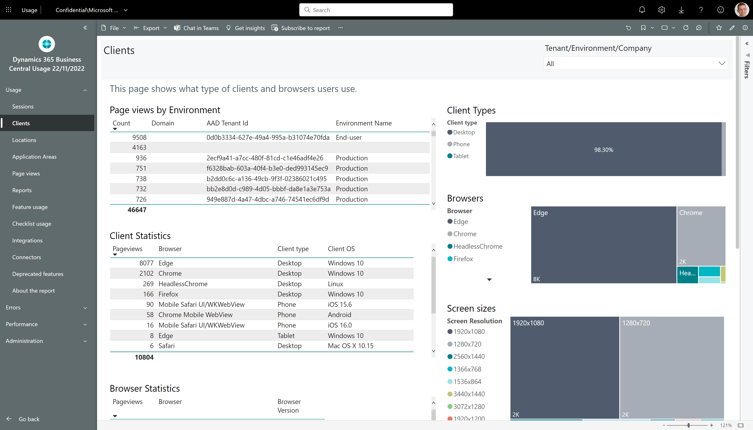
How to see which clients the users at customer use

Slide 5
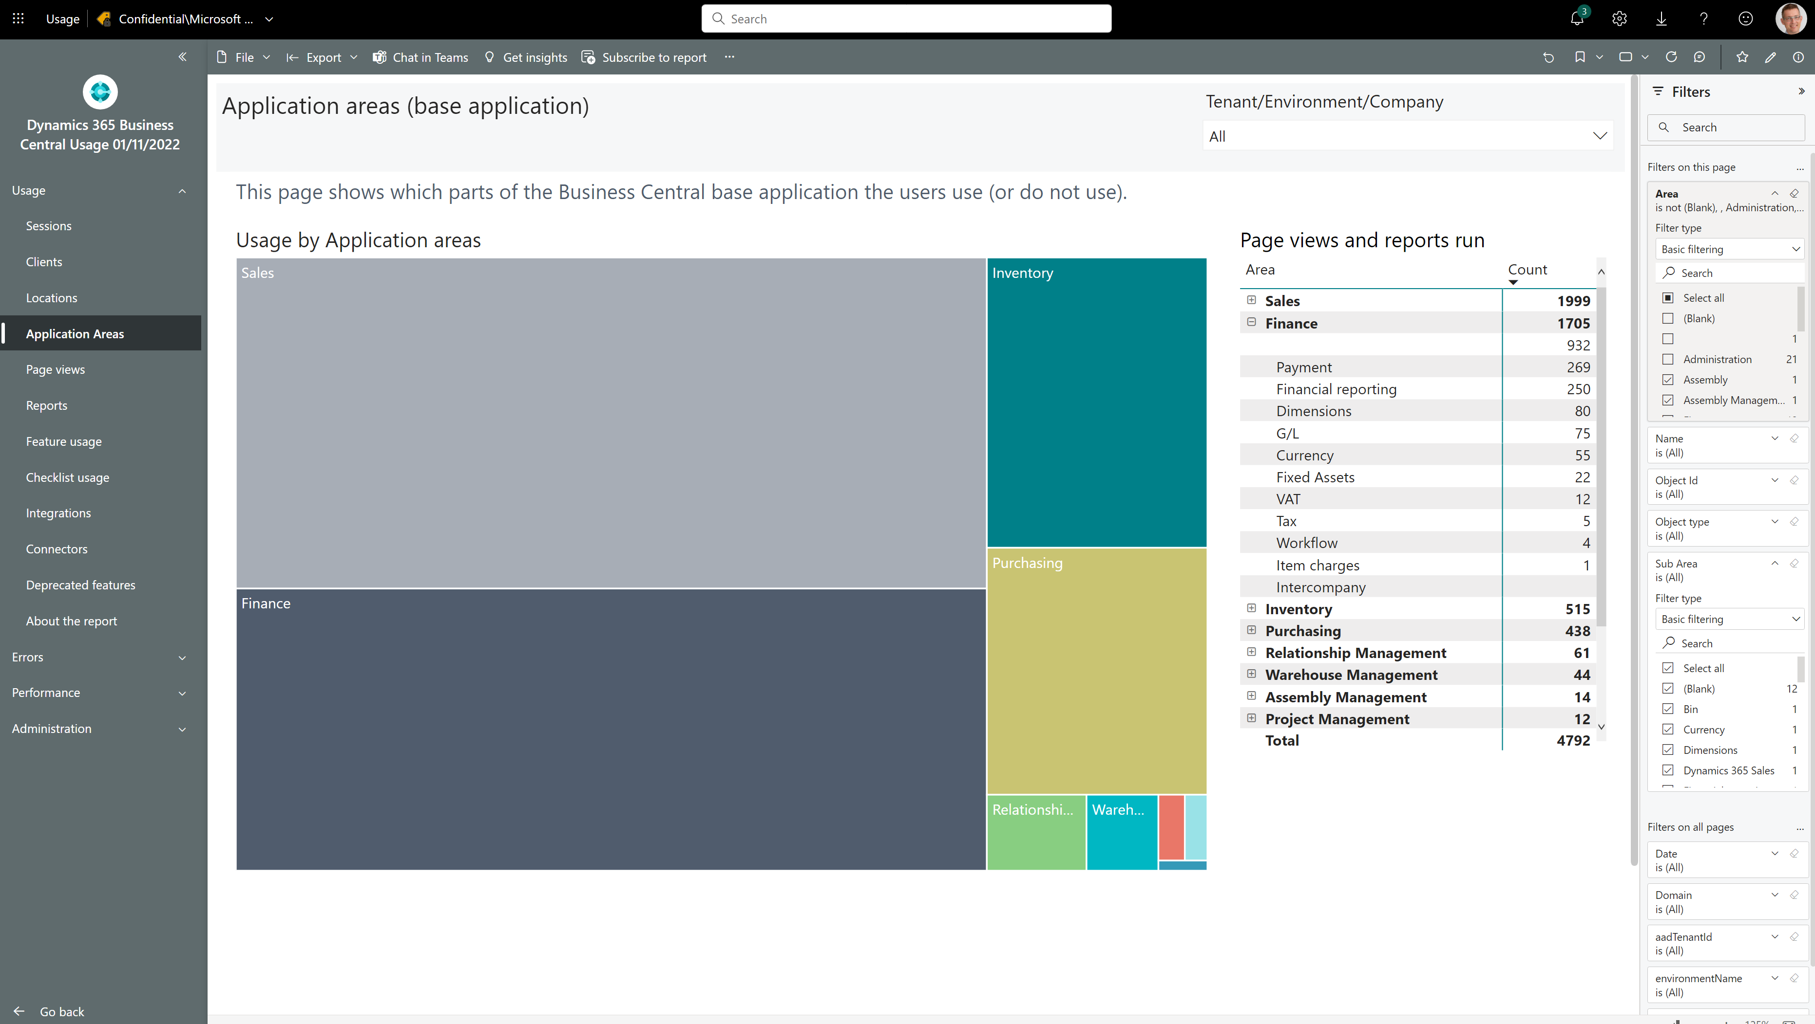
How to see which standard features customers use
Notes:
Filter away Areas with Empty, Bland, Administration, or Other

Slide 6
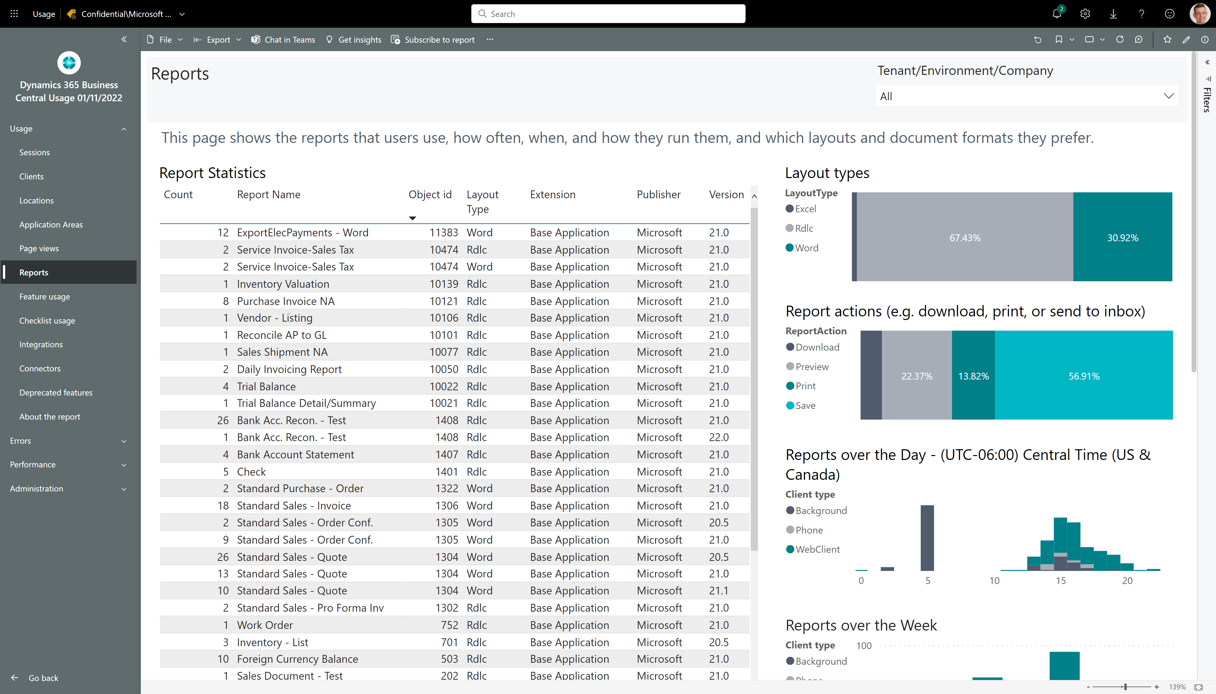
How to see if customer is using Excel layouts

Slide 7
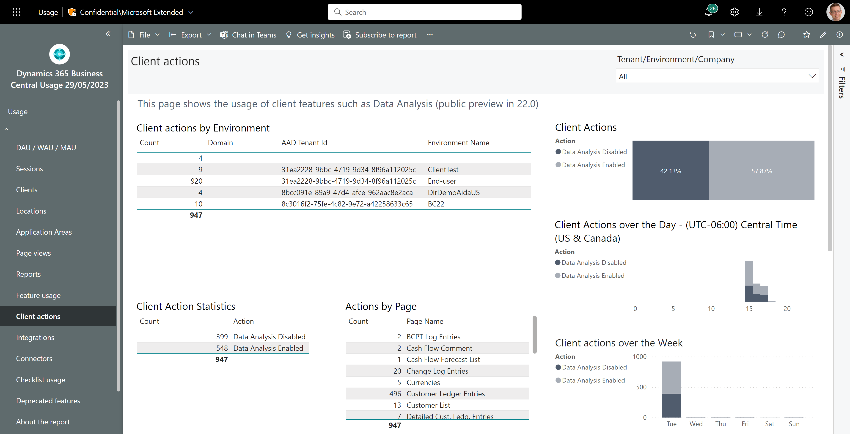
How to see if customer is using Data Analysis
Usage across customers
On which pages do they analyze data?

Slide 8
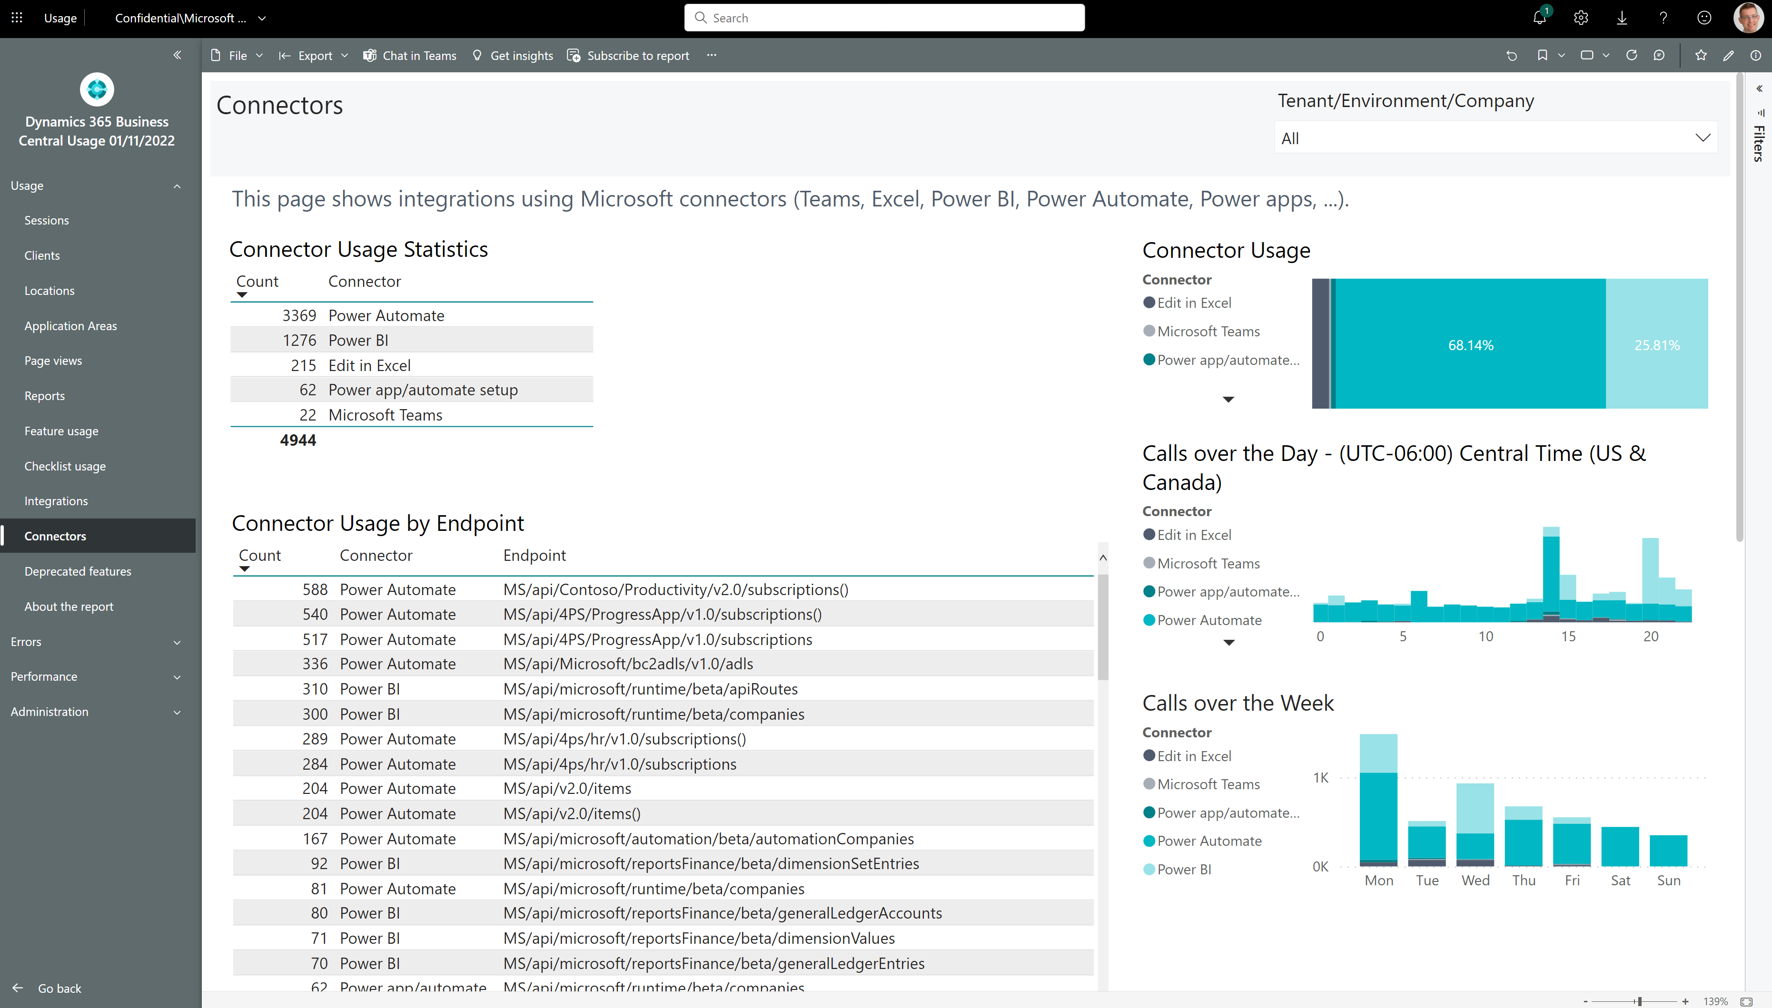
How to see if customer is using Microsoft connectors

Slide 9
Errors

Slide 10
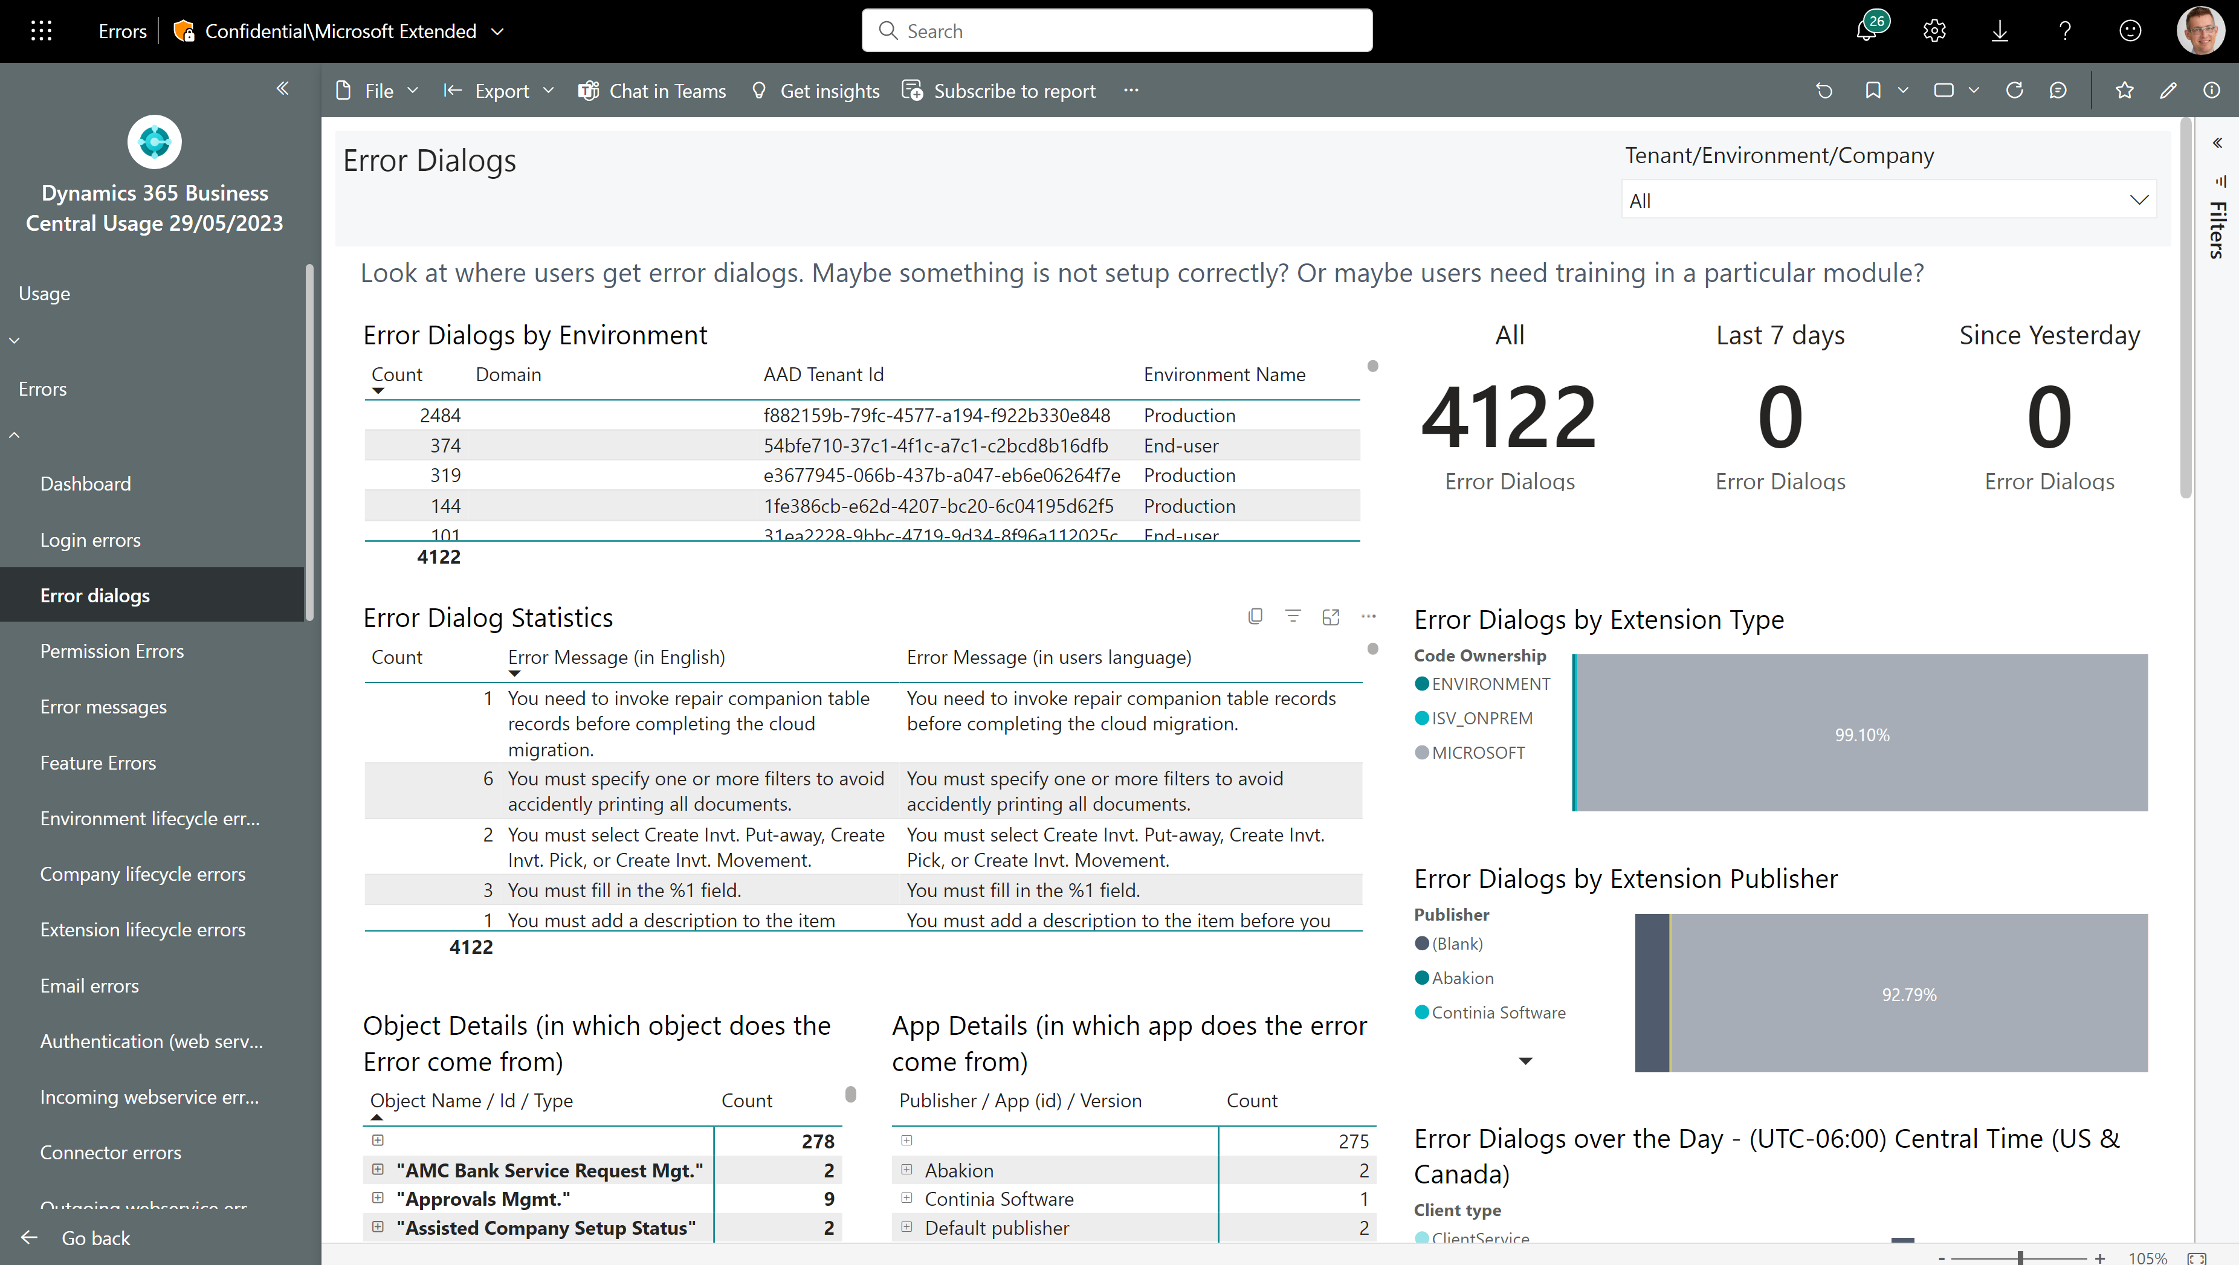
Troubleshoot errors that users see
Which customers experience errors?
What errors do users see?
And what is the error message in English?
Which apps and objects do errors come from?

Slide 11
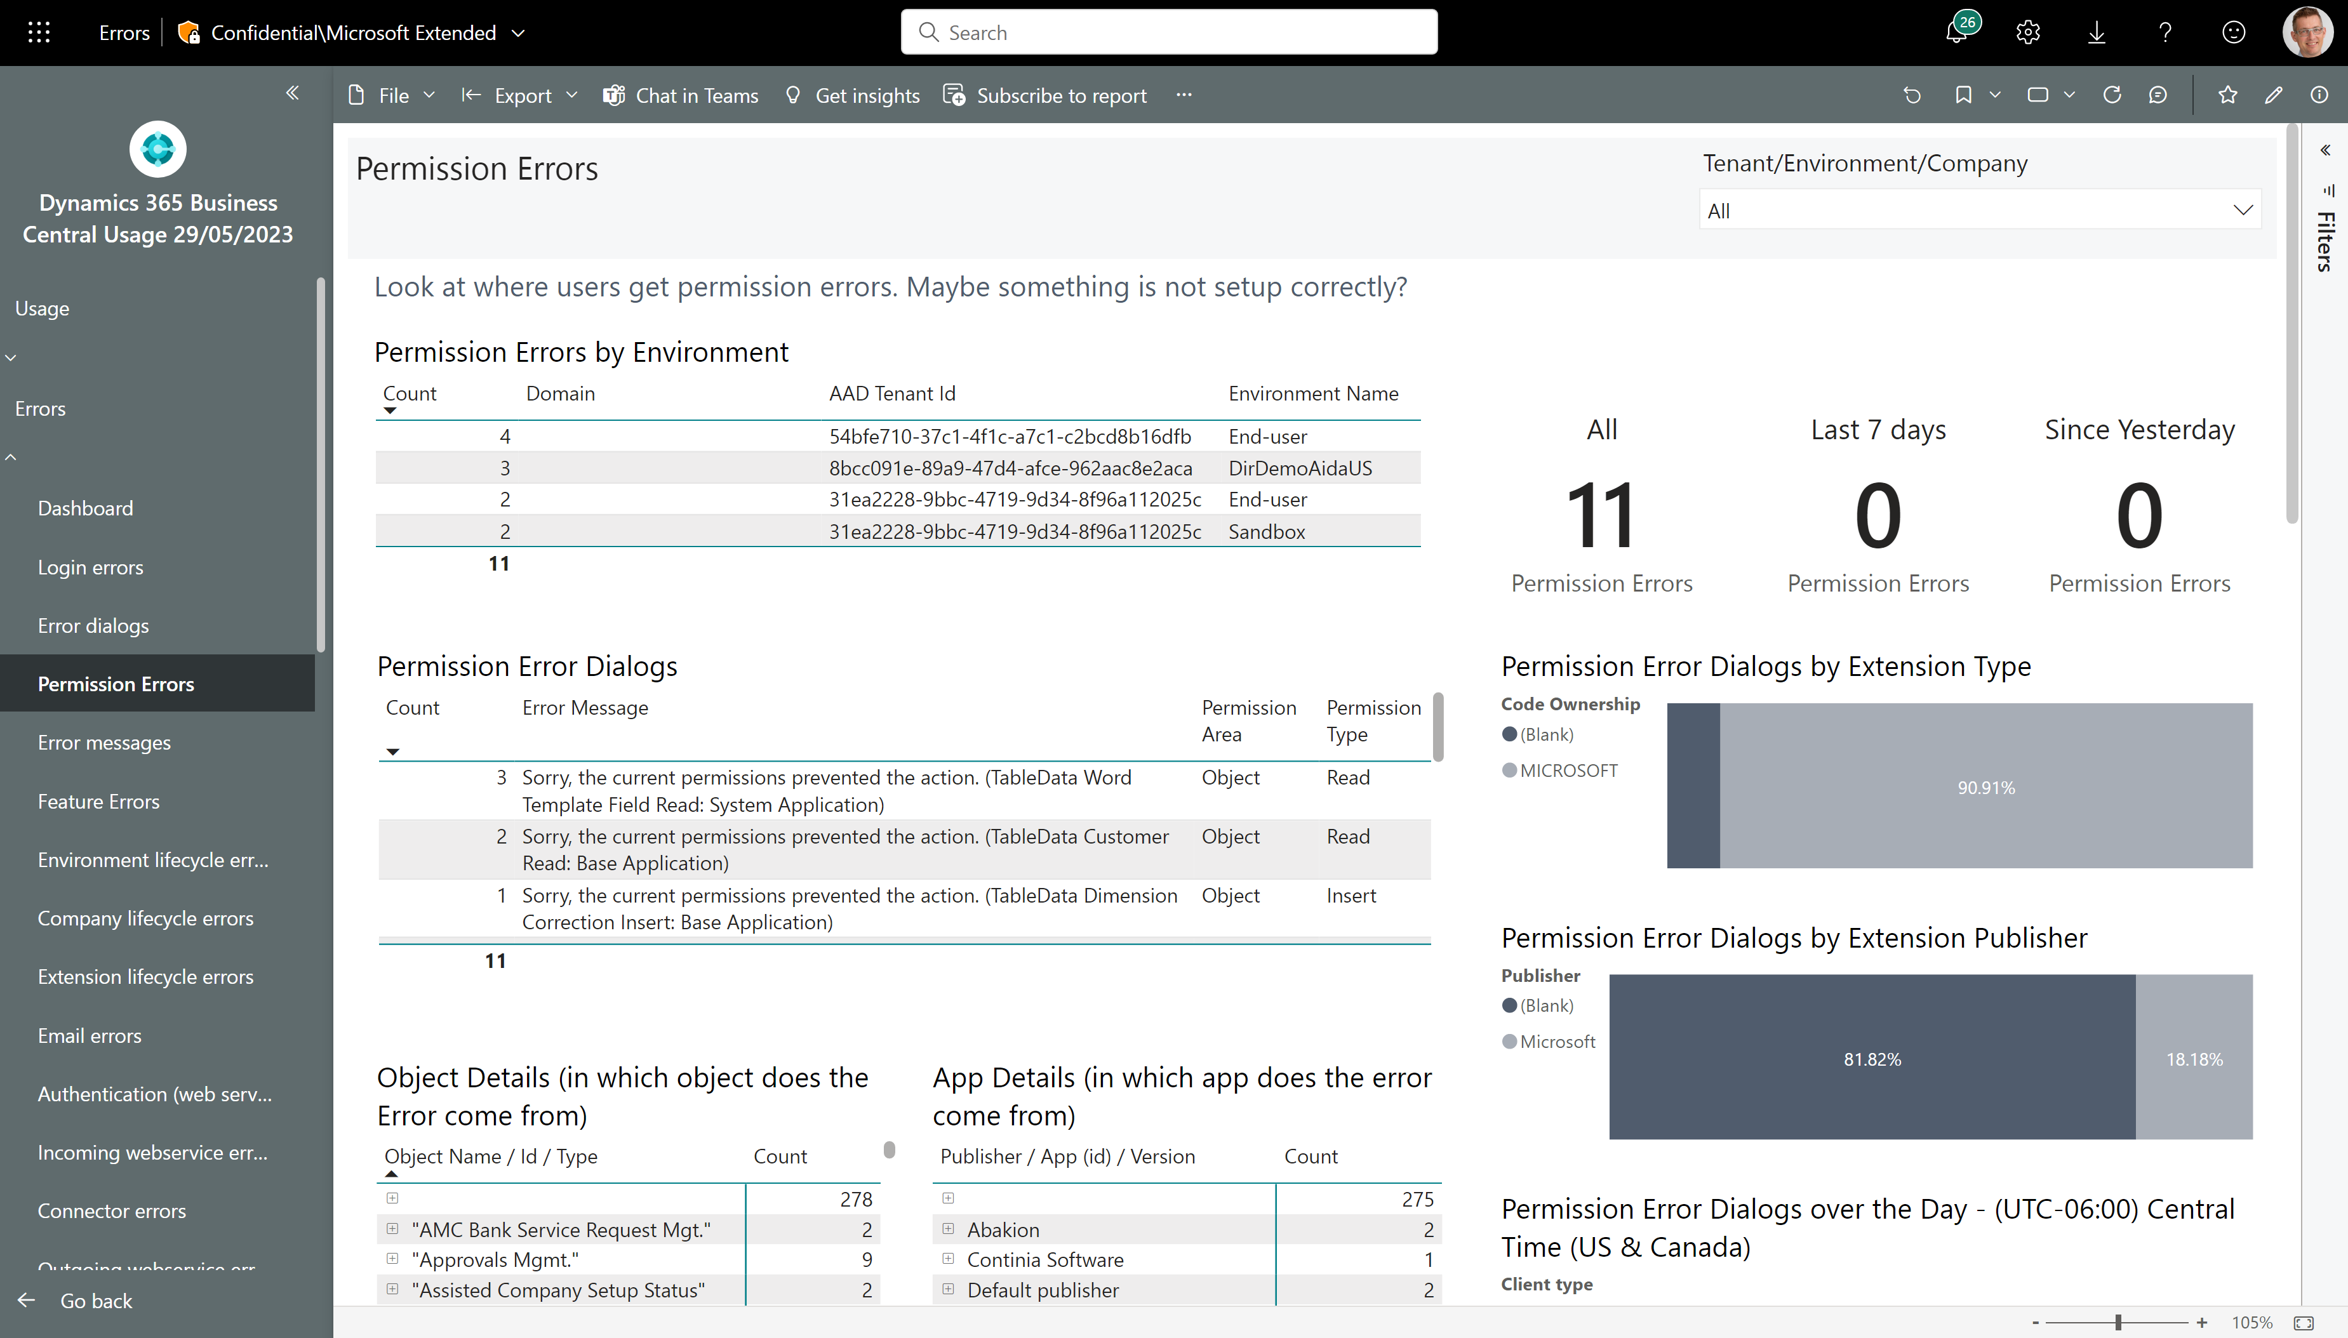
Troubleshoot permission issues
Which customers experience permission issues?
What errors do users see?
Which apps and objects do errors come from?

Slide 12
Performance

Slide 13
Tuning outgoing web service calls
Four things to consider:
Tune slow endpoints
Reduce aggressive calls
Fix non-200 HTTP errors (these just waste resources)

Slide 14
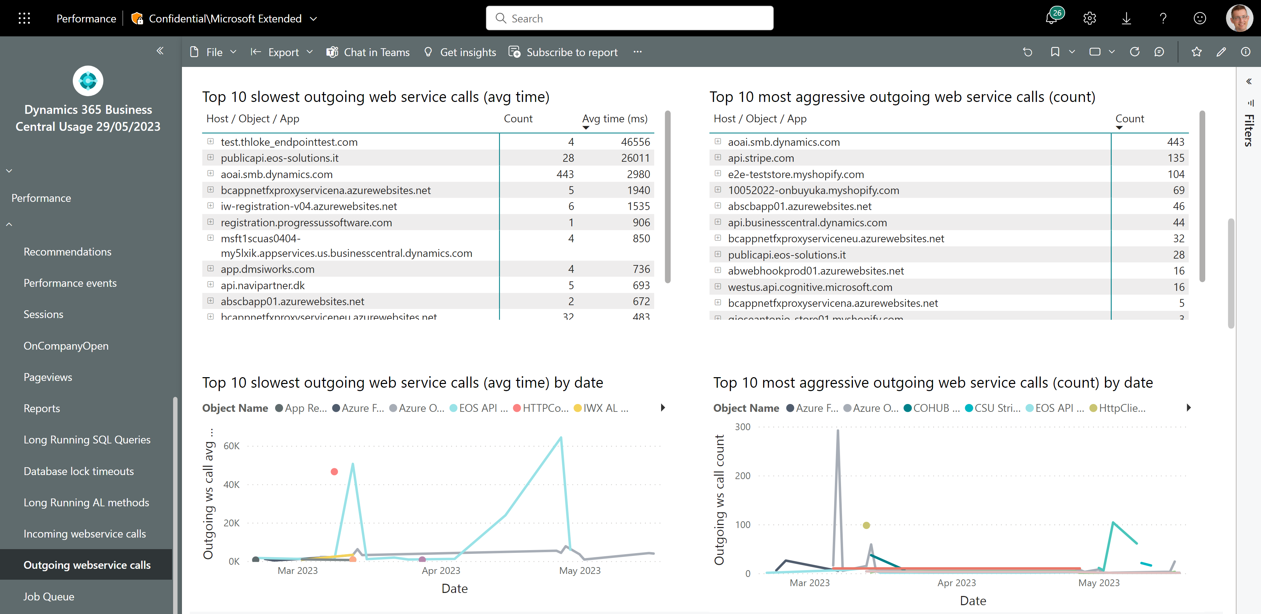
Outgoing web service performance - 1
Tune slow endpoints
Reduce aggressive calls

Slide 15
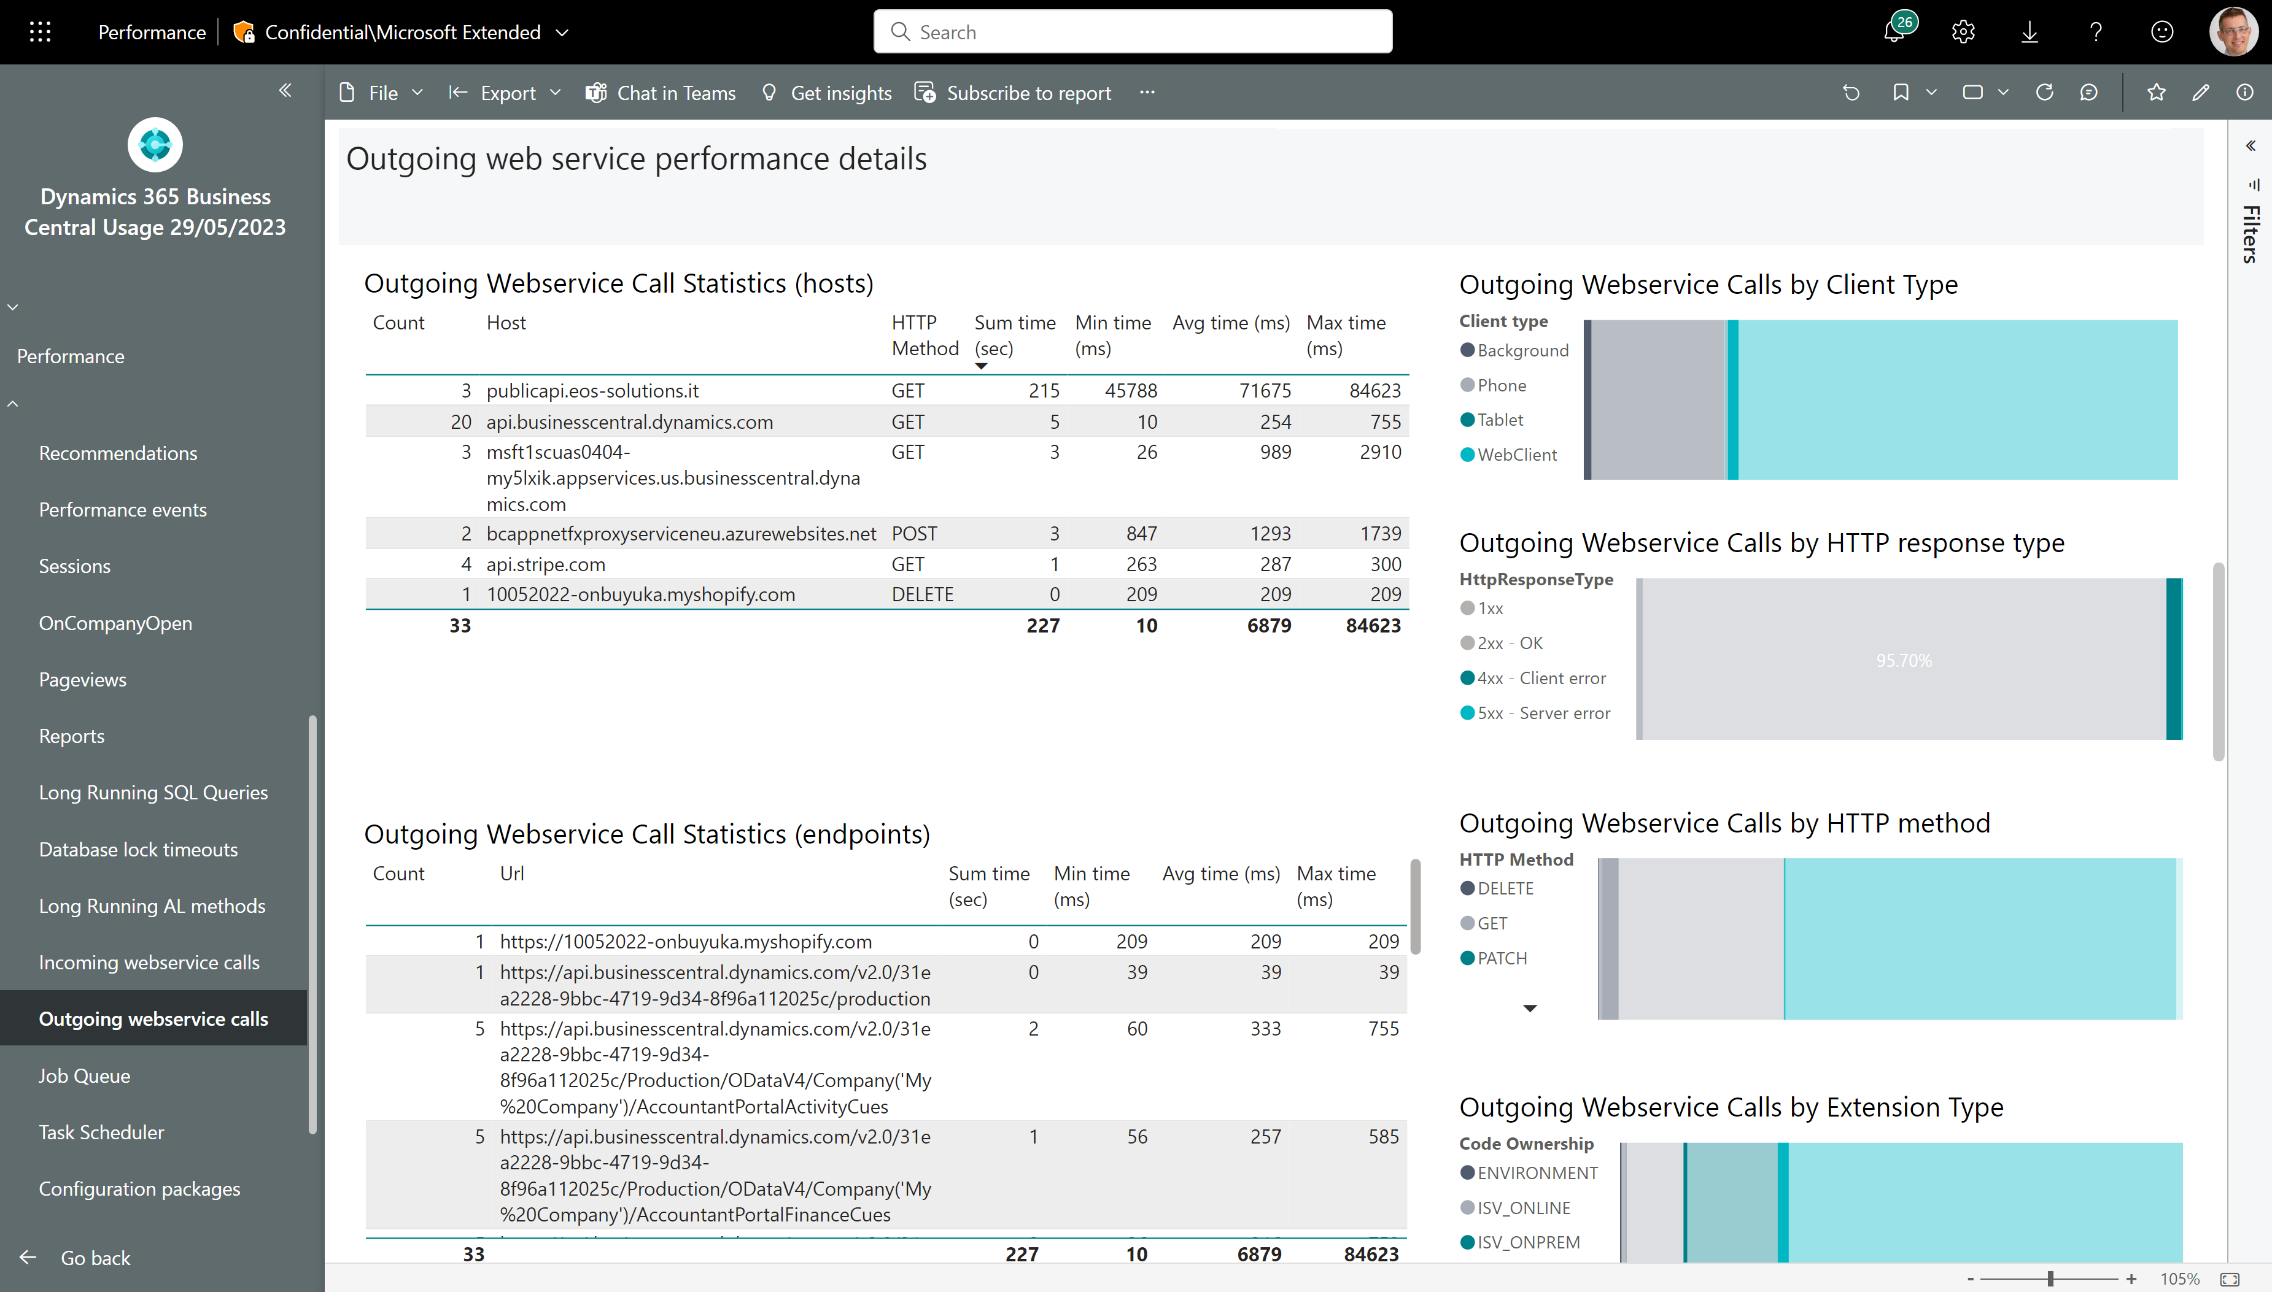
Outgoing web service performance - 2
Fix errors on these endpoints
Filter to only show errors

Slide 16
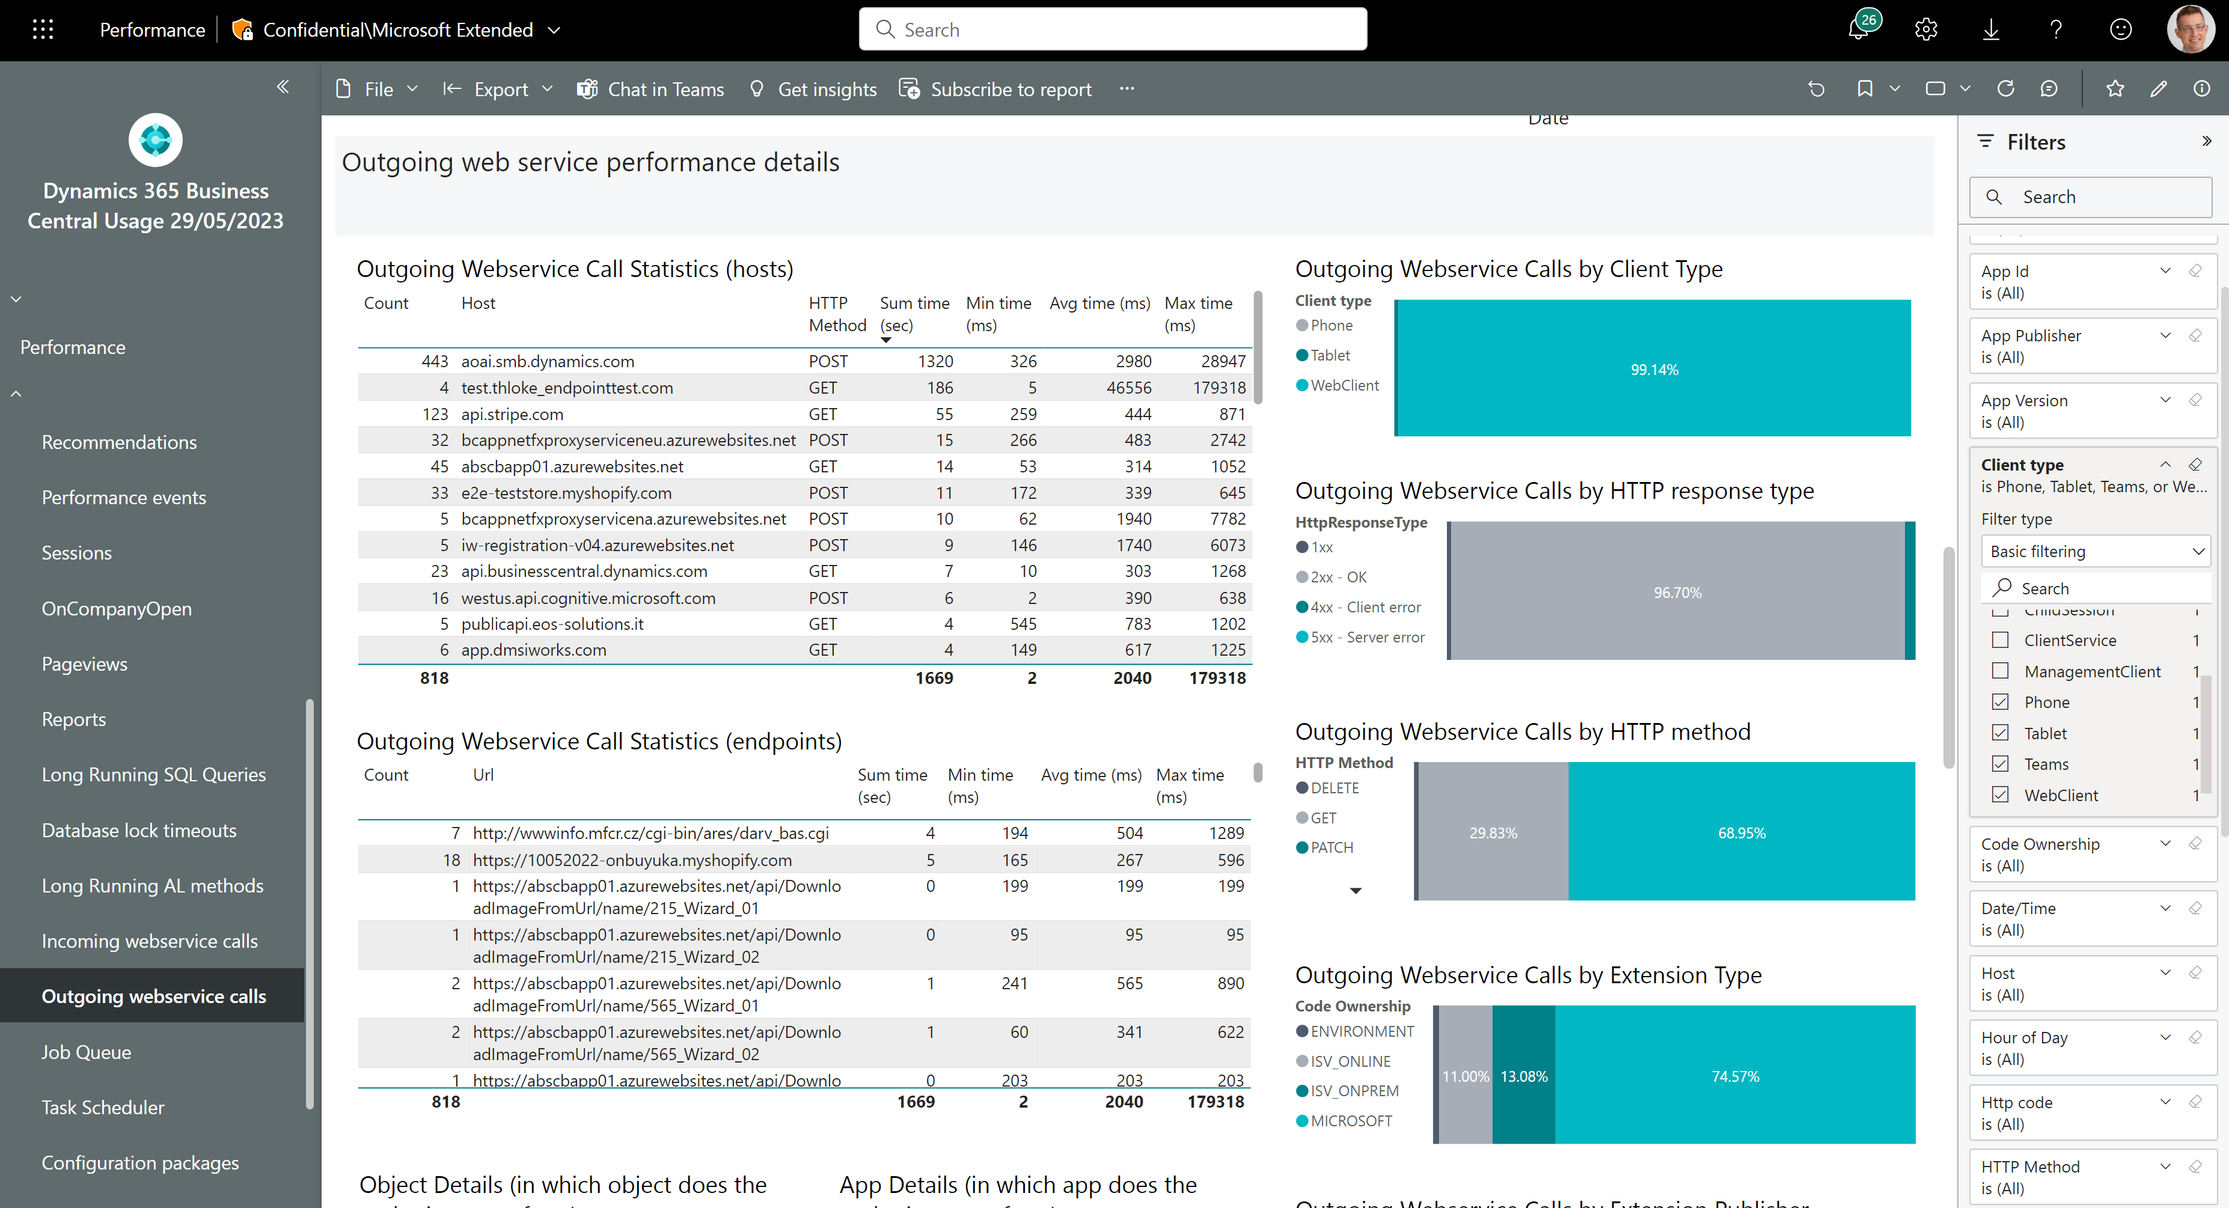
Outgoing web service performance - 3
Tune these – users wait for them in the UI
Filter to only show UI clients

Slide 17
Administration

Slide 18
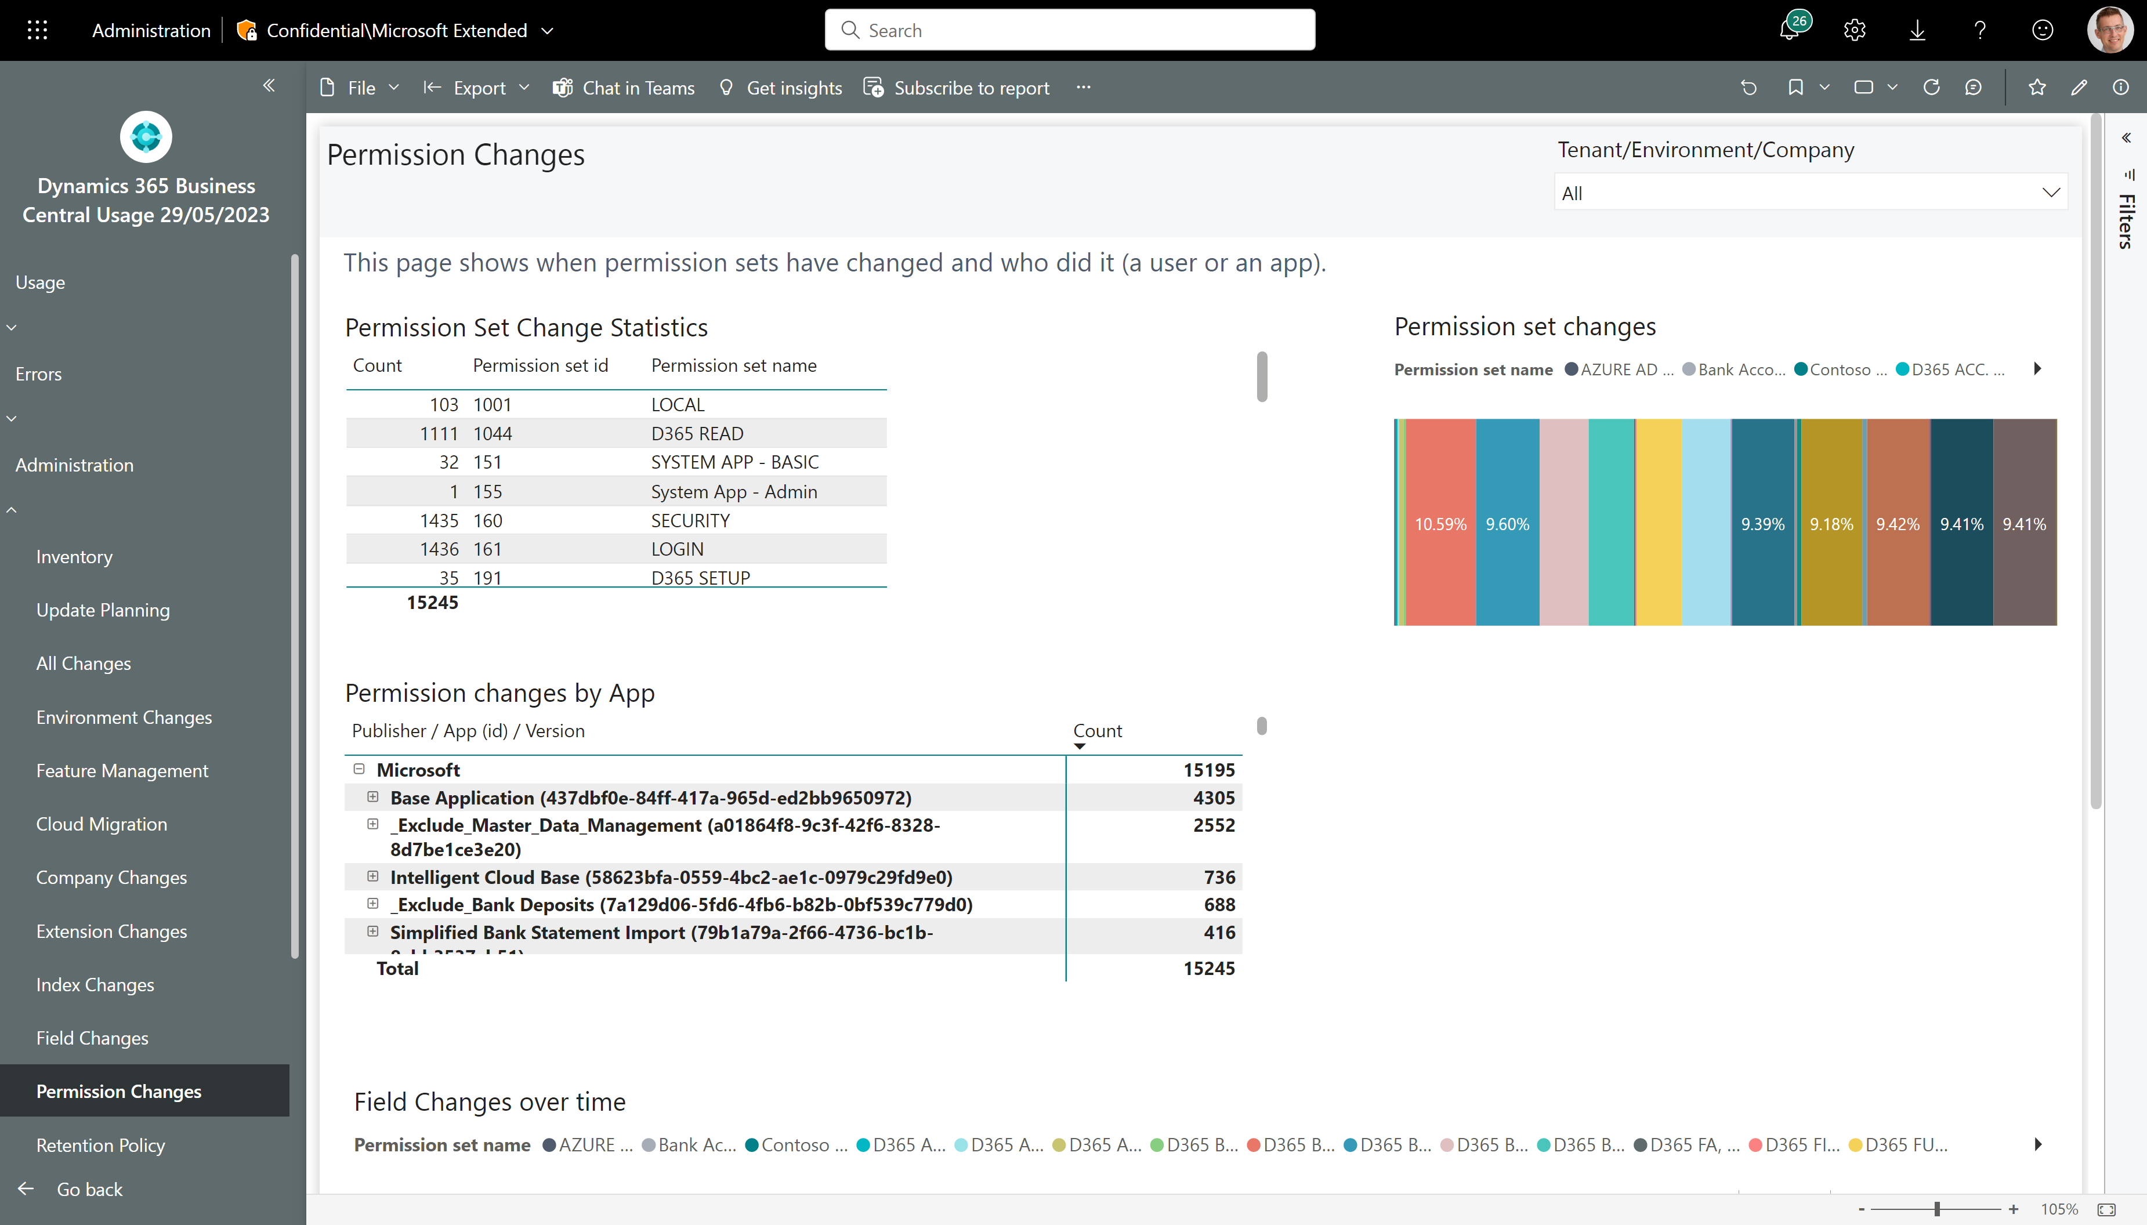
Track changes to permissions (also over time)
Which permission sets were changed?
And by which apps?
And when?

Slide 19
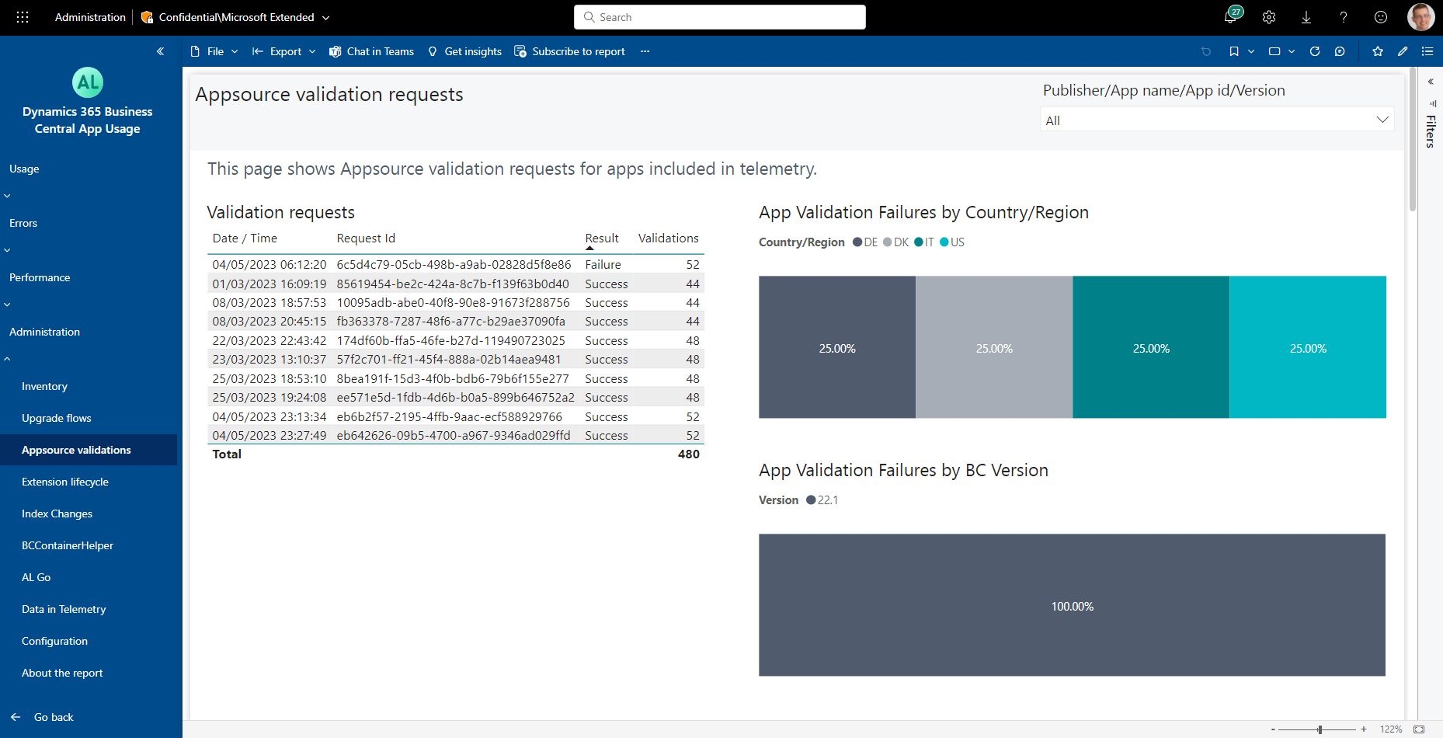
How to see the Appsource validation results
See failures by country/region
See failure rates by version

Slide 20
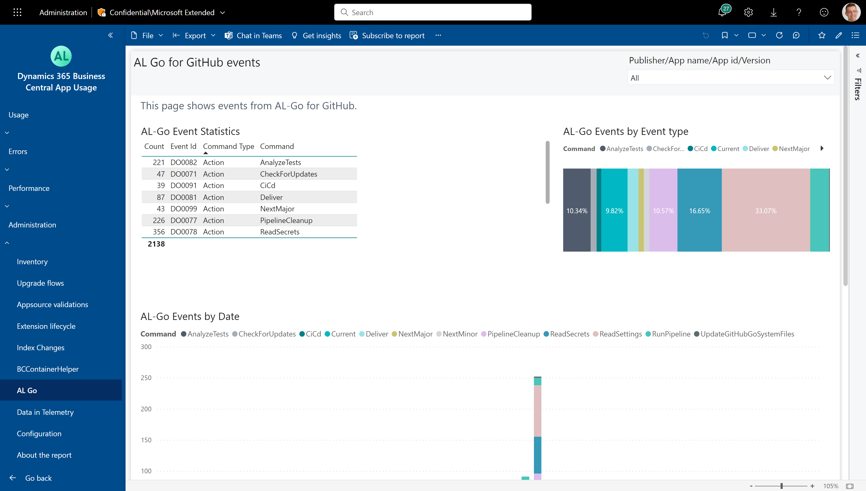
How to see the usage of AL-GO for Github

